Slide 1
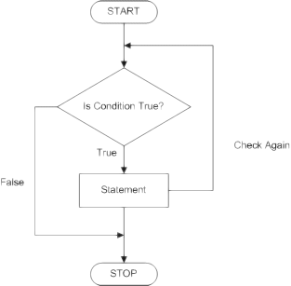
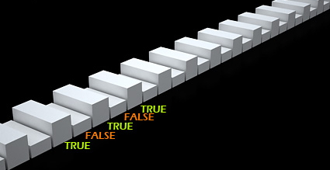
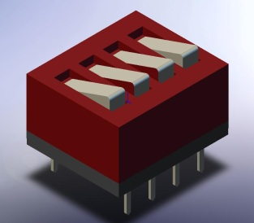
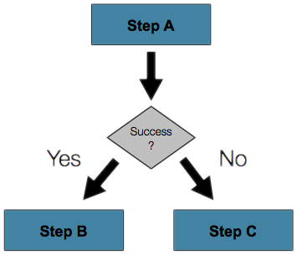

Conditional Statements
Implementing Control Logic in C#
Svetlin Nakov
Telerik Corporation
www.telerik.com

Slide 2


Table of Contents
Comparison and Logical Operators
The if Statement
The if-else Statement
Nested if Statements
The switch-case Statement
Notes:
*
(c) 2007 National Academy for Software Development - http://academy.devbg.org. All rights reserved. Unauthorized copying or re-distribution is strictly prohibited.*
<number>##

Slide 3

Comparison and Logical Operators
Notes:
*
(c) 2007 National Academy for Software Development - http://academy.devbg.org. All rights reserved. Unauthorized copying or re-distribution is strictly prohibited.*
<number>##

Slide 4
Comparison Operators
Operator | Notation in C#
Equals | ==
Not Equals | !=
Greater Than | >
Greater Than or Equals | >=
Less Than | <
Less Than or Equals | <=
Example:
bool result = 5 <= 6;
Console.WriteLine(result); // True

Slide 5

Logical Operators
Operator | Notation in C#
Logical NOT | !
Logical AND | &&
Logical OR | ||
Logical Exclusive OR (XOR) | ^
De Morgan laws
  !!A ⬄ A
  !(A || B) ⬄ !A && !B
  !(A && B) ⬄ !A || !B

Slide 6

if and if-else
Implementing Conditional Logic

Slide 7
The if Statement
The most simple conditional statement
Enables you to test for a condition
Branch to different parts of the code depending on the result
The simplest form of an if statement:
if (condition)
{
statements;
}

Slide 8

Condition and Statement
The condition can be:
  Boolean variable
  Boolean logical expression
  Comparison expression
The condition cannot be integer variable (like in C / C++)
The statement can be:
  Single statement ending with a semicolon
  Block enclosed in braces

Slide 9
How It Works?
condition
false
true
statement
The condition is evaluated
  If it is true, the statement is executed
  If it is false, the statement is skipped

Slide 10
The if Statement – Example
static void Main()
{
Console.WriteLine("Enter two numbers.");
int biggerNumber = int.Parse(Console.ReadLine());
int smallerNumber = int.Parse(Console.ReadLine());
if (smallerNumber > biggerNumber)
{
biggerNumber = smallerNumber;
}
Console.WriteLine("The greater number is: {0}",
biggerNumber);
}

Slide 11

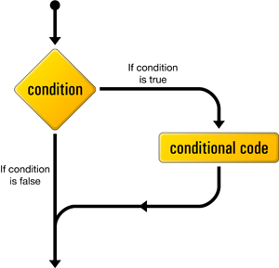
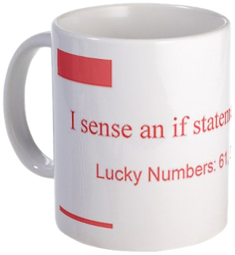
The if Statement
Live Demo
Notes:
*
(c) 2007 National Academy for Software Development - http://academy.devbg.org. All rights reserved. Unauthorized copying or re-distribution is strictly prohibited.*
<number>##

Slide 12
The if-else Statement
More complex and useful conditional statement
Executes one branch if the condition is true, and another if it is false
The simplest form of an if-else statement:
if (expression)
{
statement1;
}
else
{
statement2;
}

Slide 13
How It Works ?
condition
false
second
statement
true
first
statement
The condition is evaluated
  If it is true, the first statement is executed
  If it is false, the second statement is executed

Slide 14
if-else Statement – Example
Checking a number if it is odd or even
string s = Console.ReadLine();
int number = int.Parse(s);
if (number % 2 == 0)
{
Console.WriteLine("This number is even.");
}
else
{
Console.WriteLine("This number is odd.");
}

Slide 15
The if-else Statement
Live Demo
Notes:
*
(c) 2007 National Academy for Software Development - http://academy.devbg.org. All rights reserved. Unauthorized copying or re-distribution is strictly prohibited.*
<number>##

Slide 16
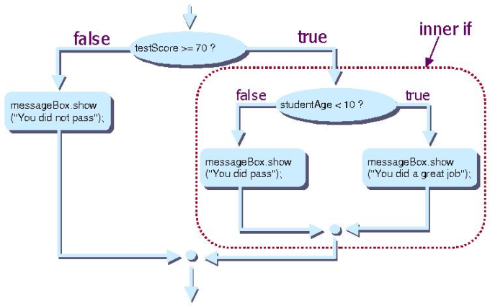
Nested if Statements
Creating More Complex Logic

Slide 17
Nested if Statements
if and if-else statements can be nested, i.e. used inside another if or else statement
Every else corresponds to its closest preceding if
if (expression)
{
if (expression)
{
statement;
}
else
{
statement;
}
}
else
statement;

Slide 18
Nested if – Good Practices
Always use { … } blocks to avoid ambiguity
  Even when a single statement follows
Avoid using more than three levels of nested if statements
Put the case you normally expect to process first, then write the unusual cases
Arrange the code to make it more readable

Slide 19
Nested if Statements – Example
if (first == second)
{
Console.WriteLine(
"These two numbers are equal.");
}
else
{
if (first > second)
{
Console.WriteLine(
"The first number is bigger.");
}
else
{
Console.WriteLine("The second is bigger.");
}
}

Slide 20
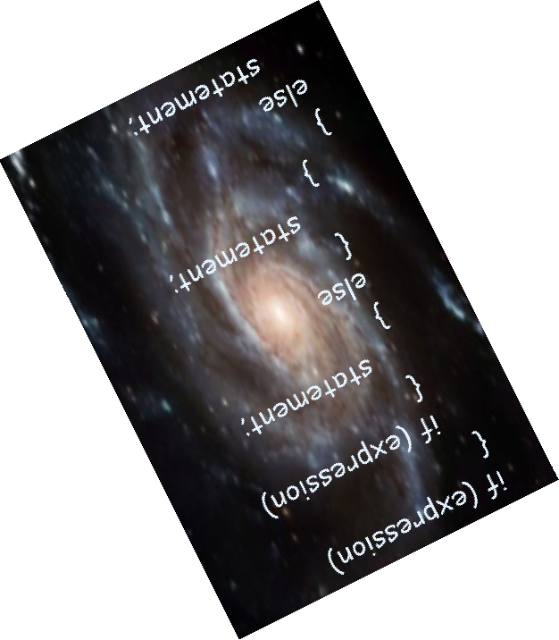
Nested if
Statements
Live Demo
Notes:
*
(c) 2007 National Academy for Software Development - http://academy.devbg.org. All rights reserved. Unauthorized copying or re-distribution is strictly prohibited.*
<number>##

Slide 21
Multiple if-else-if-else-…
Sometimes we need to use another if-construction in the else block
  Thus else if can be used:
int ch = 'X';
if (ch == 'A' || ch == 'a')
{
Console.WriteLine("Vowel [ei]");
}
else if (ch == 'E' || ch == 'e')
{
Console.WriteLine("Vowel [i:]");
}
else if …
else …

Slide 22
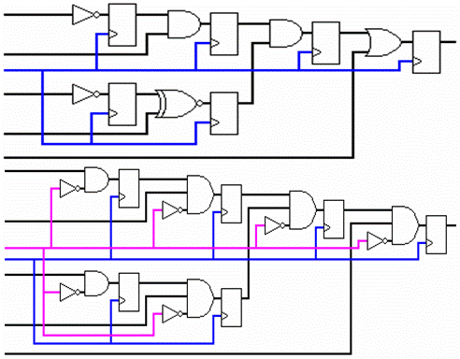
Multiple if-else
Statements
Live Demo
Notes:
*
(c) 2007 National Academy for Software Development - http://academy.devbg.org. All rights reserved. Unauthorized copying or re-distribution is strictly prohibited.*
<number>##

Slide 23

switch-case
Making Several Comparisons at Once
Notes:
*
(c) 2007 National Academy for Software Development - http://academy.devbg.org. All rights reserved. Unauthorized copying or re-distribution is strictly prohibited.*
<number>##

Slide 24
The switch-case Statement
Selects for execution a statement from a list depending on the value of the switch expression
switch (day)
{
case 1: Console.WriteLine("Monday"); break;
case 2: Console.WriteLine("Tuesday"); break;
case 3: Console.WriteLine("Wednesday"); break;
case 4: Console.WriteLine("Thursday"); break;
case 5: Console.WriteLine("Friday"); break;
case 6: Console.WriteLine("Saturday"); break;
case 7: Console.WriteLine("Sunday"); break;
default: Console.WriteLine("Error!"); break;
}

Slide 25
How switch-case Works?
The expression is evaluated
When one of the constants specified in a case label is equal to the expression
  The statement that corresponds to that case is executed
If no case is equal to the expression
  If there is default case, it is executed
  Otherwise the control is transferred to the end point of the switch statement

Slide 26

The switch-case Statement
Live Demo
Notes:
*
(c) 2007 National Academy for Software Development - http://academy.devbg.org. All rights reserved. Unauthorized copying or re-distribution is strictly prohibited.*
<number>##

Slide 27
Using switch: Rules
Variables types like string, enum and integral types can be used for switch expression
The value null is permitted as a case label constant
The keyword break exits the switch statement
"No fall through" rule – you are obligated to use break after each case
Multiple labels that correspond to the same statement are permitted

Slide 28
Multiple Labels – Example
You can use multiple labels to execute the same statement in more than one case
switch (animal)
{
case "dog" :
Console.WriteLine("MAMMAL");
break;
case "crocodile" :
case "tortoise" :
case "snake" :
Console.WriteLine("REPTILE");
break;
default :
Console.WriteLine("There is no such animal!");
break;
}

Slide 29

Multiple Labels in a switch-case
Live Demo
Notes:
*
(c) 2007 National Academy for Software Development - http://academy.devbg.org. All rights reserved. Unauthorized copying or re-distribution is strictly prohibited.*
<number>##

Slide 30
Using switch – Good Practices
There must be a separate case for every normal situation
Put the normal case first
  Put the most frequently executed cases first and the least frequently executed last
Order cases alphabetically or numerically
In default use case that cannot be reached under normal circumstances

Slide 31
Summary
Comparison and logical operators are used to compose logical conditions
The conditional statements if and if-else provide conditional execution of blocks of code
  Constantly used in computer programming
  Conditional statements can be nested
The switch statement easily and elegantly checks an expression for a sequence of values
Notes:
*
(c) 2007 National Academy for Software Development - http://academy.devbg.org. All rights reserved. Unauthorized copying or re-distribution is strictly prohibited.*
<number>##

Slide 32






Conditional Statements
http://academy.telerik.com

Slide 33
Exercises
Write an if statement that examines two integer variables and exchanges their values if the first one is greater than the second one.
Write a program that shows the sign (+ or -) of the product of three real numbers without calculating it. Use a sequence of if statements.
Write a program that finds the biggest of three integers using nested if statements.
Sort 3 real values in descending order using nested if statements.
Notes:
*
(c) 2007 National Academy for Software Development - http://academy.devbg.org. All rights reserved. Unauthorized copying or re-distribution is strictly prohibited.*
<number>##

Slide 34
Exercises (2)
Write program that asks for a digit and depending on the input shows the name of that digit (in English) using a switch statement.
Write a program that enters the coefficients a, b and c of a quadratic equation
a*x2 + b*x + c = 0
and calculates and prints its real roots. Note that quadratic equations may have 0, 1 or 2 real roots.
Write a program that finds the greatest of given 5 variables.

Slide 35
Exercises (3)
Write a program that, depending on the user's choice inputs int, double or string variable. If the variable is integer or double, increases it with 1. If the variable is string, appends "*" at its end. The program must show the value of that variable as a console output. Use switch statement.
We are given 5 integer numbers. Write a program that checks if the sum of some subset of them is 0. Example: 3, -2, 1, 1, 8 → 1+1-2=0.
Notes:
*
(c) 2007 National Academy for Software Development - http://academy.devbg.org. All rights reserved. Unauthorized copying or re-distribution is strictly prohibited.*
<number>##

Slide 36
Exercises (4)
Write a program that applies bonus scores to given scores in the range [1..9]. The program reads a digit as an input. If the digit is between 1 and 3, the program multiplies it by 10; if it is between 4 and 6, multiplies it by 100; if it is between 7 and 9, multiplies it by 1000. If it is zero or if the value is not a digit, the program must report an error.
Use a switch statement and at the end print the calculated new value in the console.

Slide 37
Exercises (5)
* Write a program that converts a number in the range [0...999] to a text corresponding to its English pronunciation. Examples:
0 → "Zero"
273 → "Two hundred seventy three"
400 → "Four hundred"
501 → "Five hundred and one"
711 → "Seven hundred and eleven"
Notes:
*
(c) 2007 National Academy for Software Development - http://academy.devbg.org. All rights reserved. Unauthorized copying or re-distribution is strictly prohibited.*
<number>##

